Slide 1
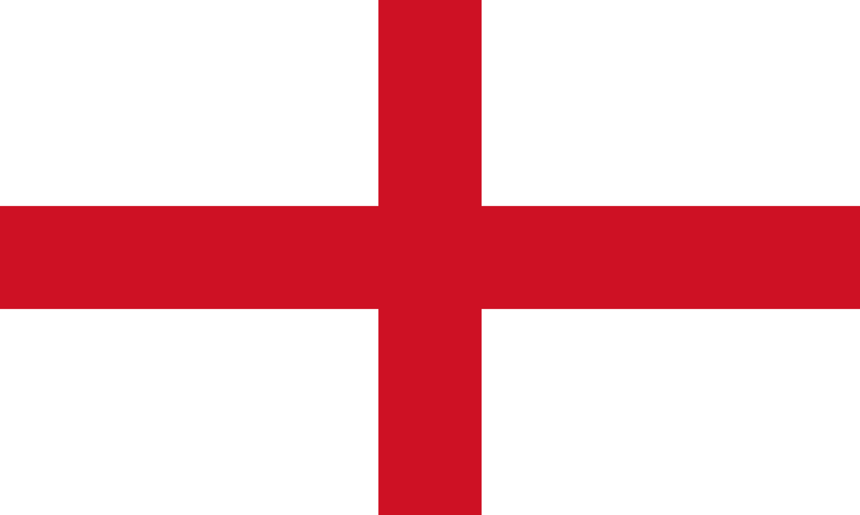
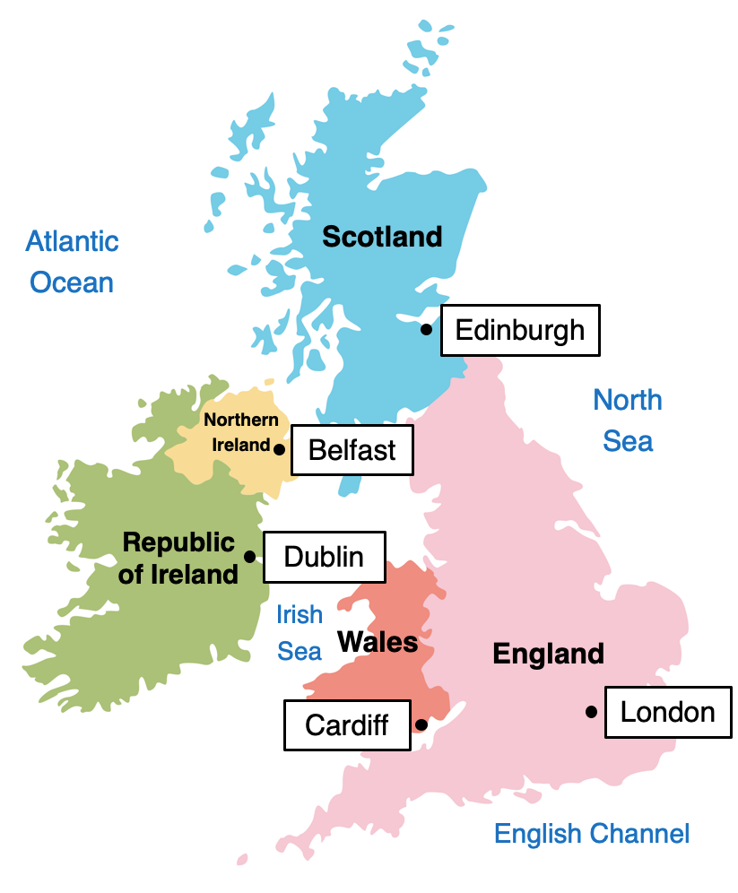
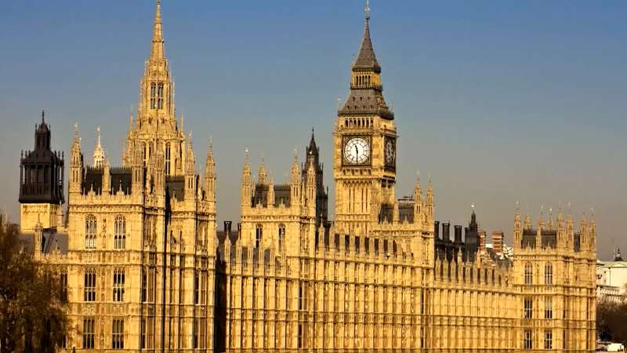
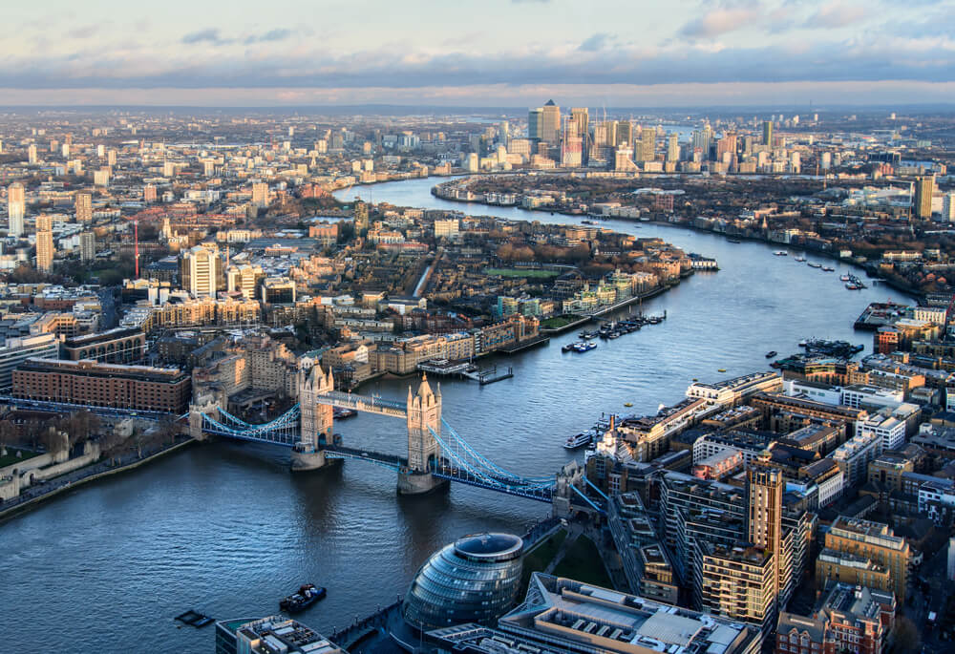
Y4-5 Knowledge Organiser – London Calling!
United Kingdom
The United Kingdom, also known as the UK, is a country located in Europe.
The UK includes the countries England, Scotland, Wales and Northern Ireland.
The coastline of the UK is over 12,000 km long – long enough to reach the centre of the Earth and back!
London
The capital city of the UK and England is London.
London is the largest city in the UK.
100 years ago, London was the biggest city in the world.
It was founded by the Romans and The River Thames runs through it.
Landmarks include Big Ben, Houses of Parliament and Buckingham Palace.
The flag of England
England
England is the largest of the four countries within the UK.
The highest mountain in England is Scafell Pike (977m).
The longest river in England is the River Thames (346 km).
The largest lake in England is Lake Windermere.
England has a population of 53.5 million people.
The Houses of Parliament
The River Thames
Key Vocabulary | Definition
County | Areas that countries or states are divided into.
U.K. | The United Kingdom of Great Britain and Northern Ireland.
Great Britain | England, Scotland and Wales.
Agriculture | Another word for farming. The growing and harvesting of crops and/or breeding animals.
Rural | Countryside or farmland.
Urban | Towns and cities.
Island | A piece of land that is completely surrounded by water.
Sea | A large area of salty water that is part of an ocean.

