Slide 1
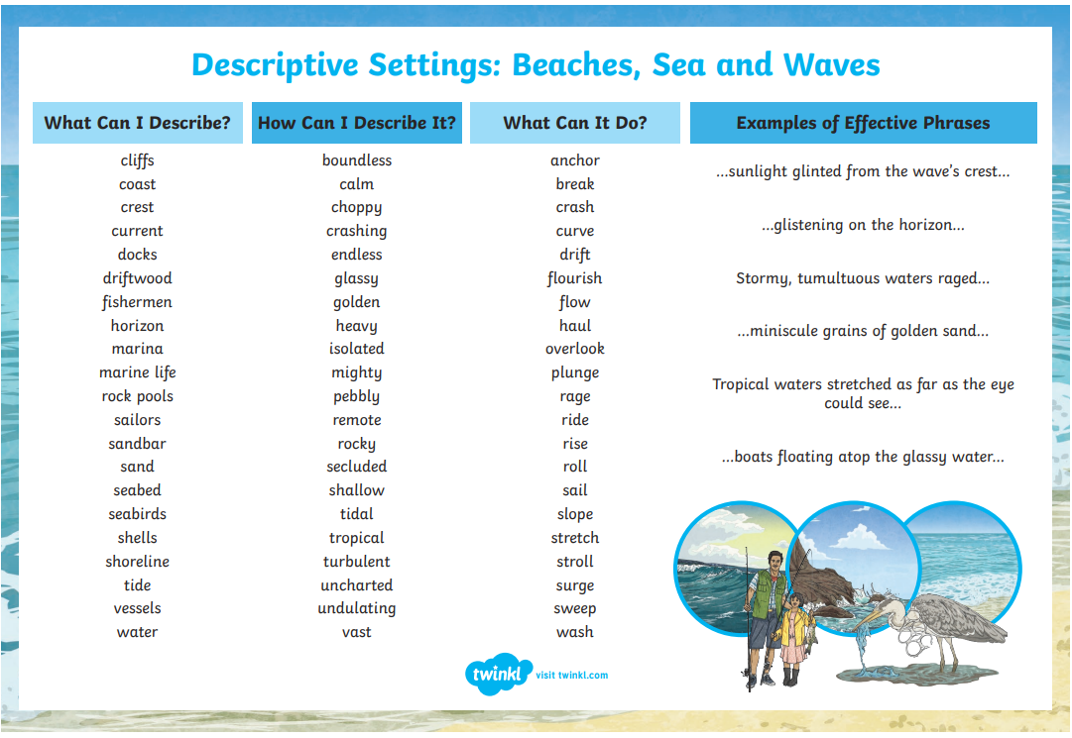
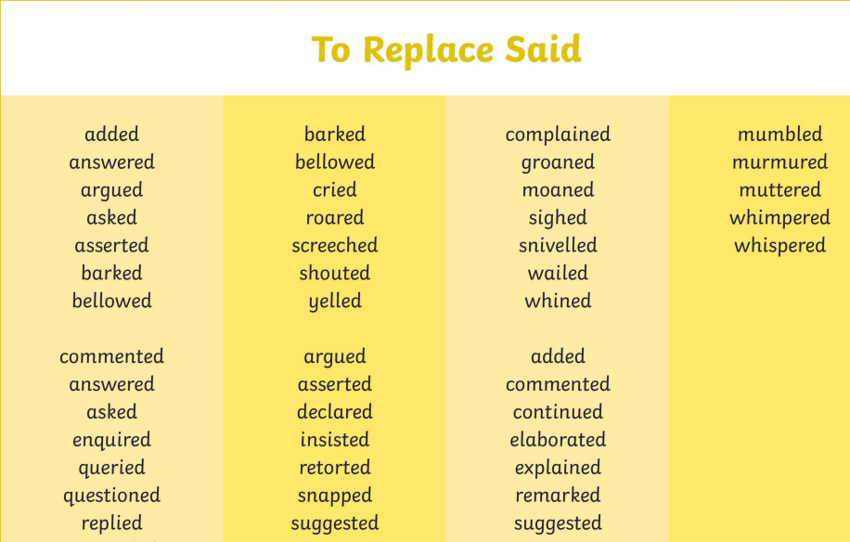
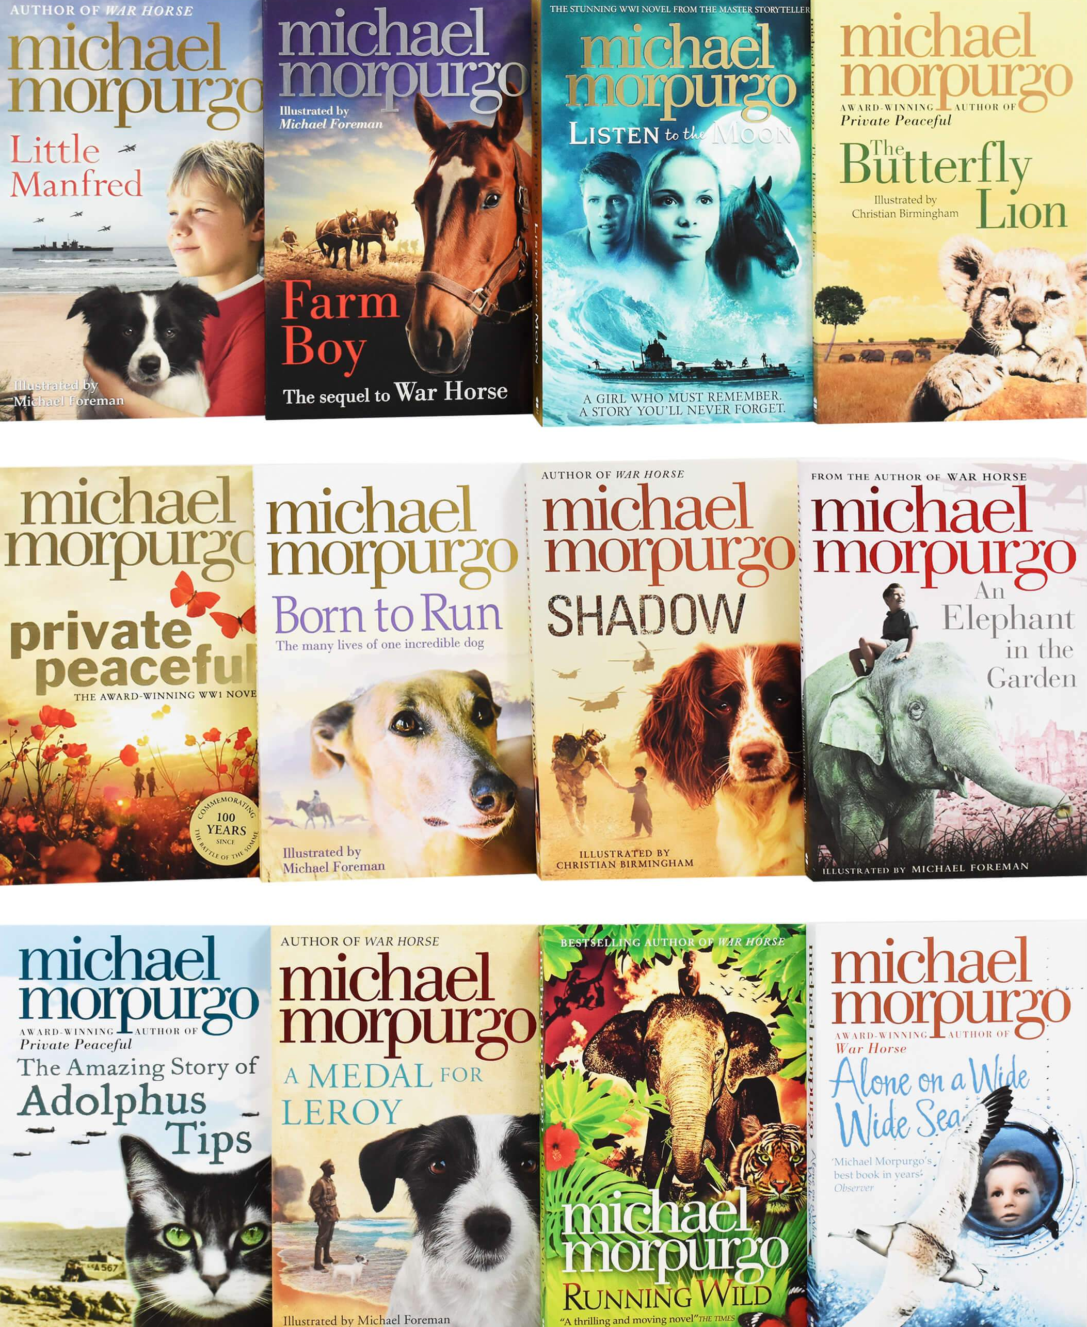
Michael Morpurgo- Sea stories
.
.
.
Fiction elements-
Character- who is in the story?
Plot- the events that make up a story.
Setting- where the story happens.
Style- the way a writer tells the story.
Theme- the main ideas that run through a text.
Some of Michaels best selling books are…
War Horse
Kensuke’s Kingdom
Butterfly Lion
Born to
Run
This Morning
I Saved a Whale
Shadow
Non Fiction elements-
Real people, places and events

