Slide 1
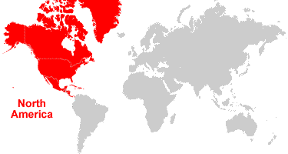
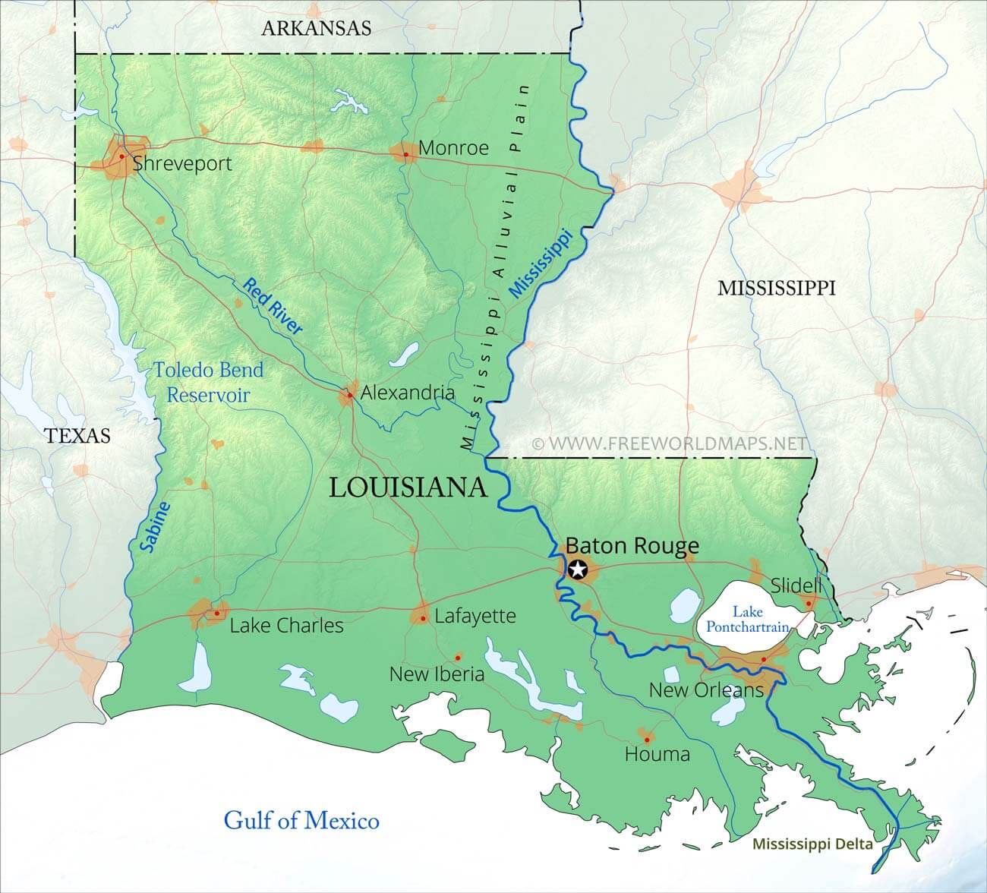
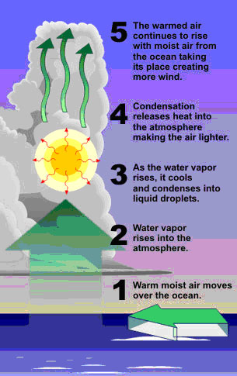
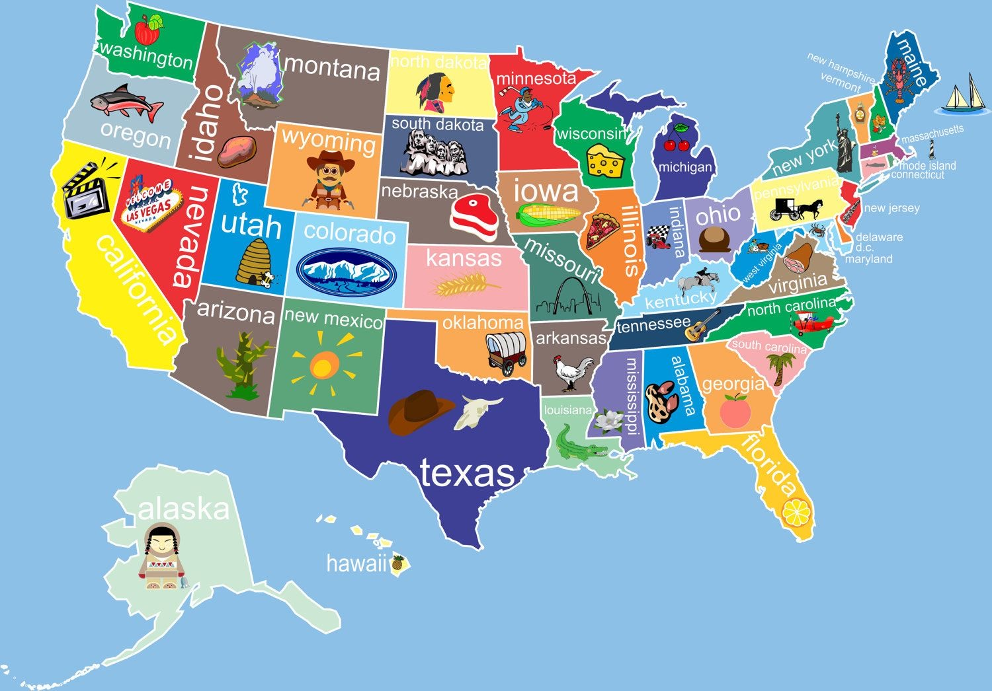
Lodge Lane to Louisiana Yr 5 Knowledge Organiser
Where is North America?
North America is the third largest of the seven continents.
It is bordered by the Atlantic Ocean to the east and the Pacific Ocean to the west.
North America’s three largest countries: Canada, Mexico, and the United States.
The Mississippi – Missouri river system longest river in North America
Lake Superior found between USA and Canada is the largest fresh water lake in the world.
Louisiana State
How a hurricane works
The States
The USA is so big that it is broken up into 50 states/areas. The national capital is Washington D.C. Each states vary in climate, population, land use and has its own capital too.
Capital: Baton Rouge
Largest city: New Orleans
Population: 4.5 million
Climate: Subtropical
Culture: a “melting pot” of French, Canadian, African, and modern American
Famous for: Mardi Gras carnival, food and Jazz music
Weather and Climate
Weather is a specific event—like a rainstorm or hot day—that happens over a few hours, days or weeks.
Climate is the average weather conditions in a place over 30 years or more. NASA has observed that Earth's climate is getting warmer.
Hurricane Katrina
The costliest natural disaster in American History
Struck Louisiana state in August 2005
Caused 1,800 deaths

