Slide 1
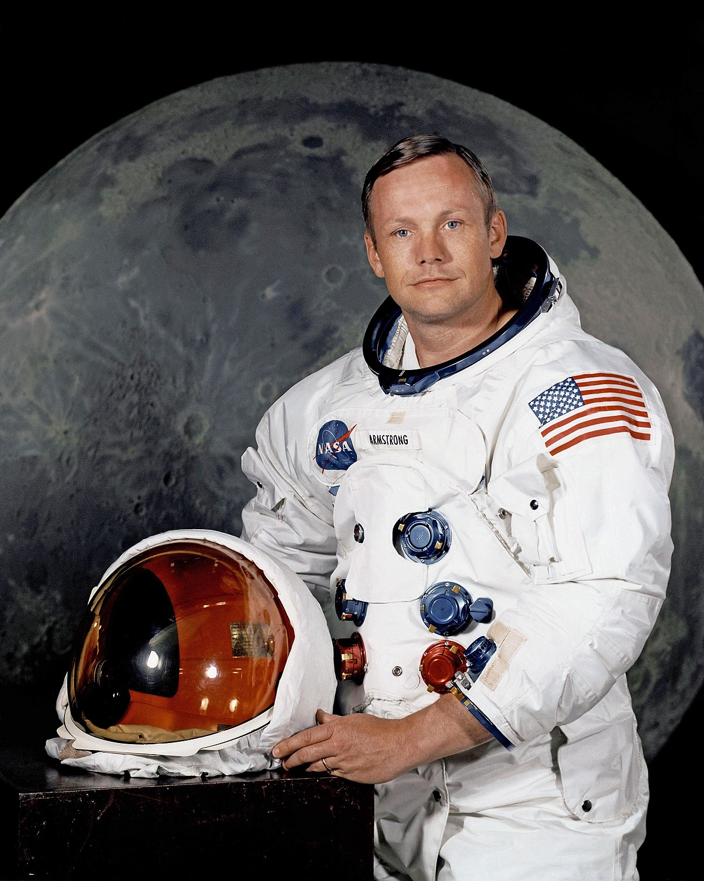
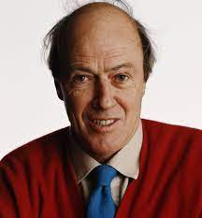
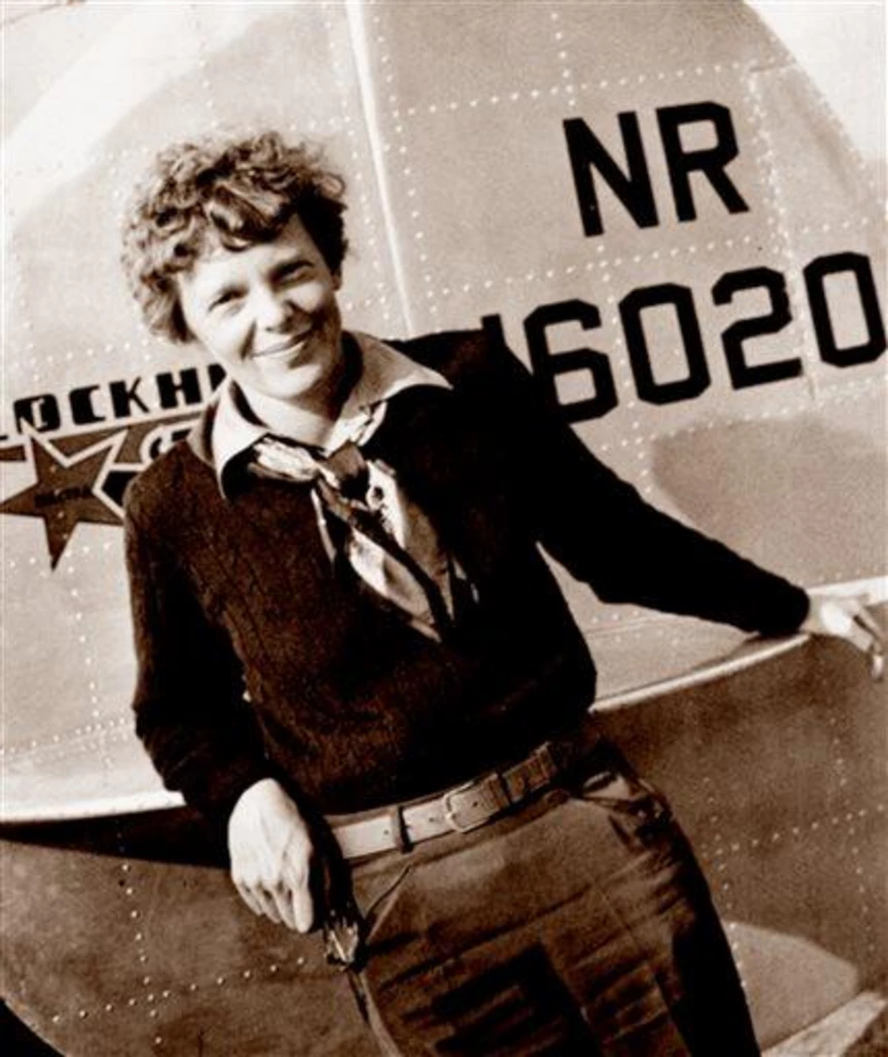
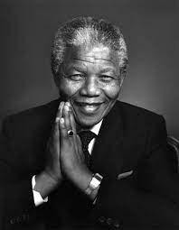
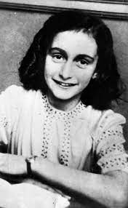
Famous for more than 5 minutes.
Neil Armstrong
Astronaut.
Not alive anymore.
Born in America.
First man on the moon.
His rocket was called Apollo 11.
Topic words
.Nelson Mandela
President.
not alive anymore.
Born in South Africa
The first black president of South Africa.
He went to prison for a long time for something he didn’t do.
Roald Dahl
Author .
Not alive anymore.
Born in England.
Wrote 50 amazing books.
His daughter died as she was very poorly.
Amelia Earhart
Pilot.
Not alive anymore.
Born in America.
The first woman to fly on her own across the Atlantic Ocean..
She was also a nurse.
.Anne Frank
School girl.
Not alive anymore.
Born in Germany.
She went into hiding in the war to keep safe.
She stayed in hiding for about 2 years.

Slide 2
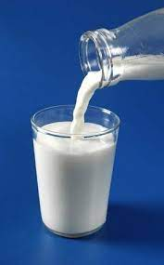
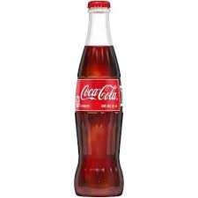
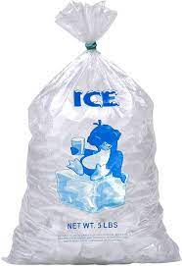
Science Homework Task Summer 2
This half term our science topic is changing materials.
Homework task
Look around your house and try and spot things that are solids and liquids. Look at some ice cubes. Are they solid or liquid?

