Slide 1
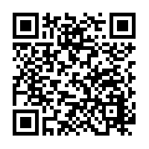
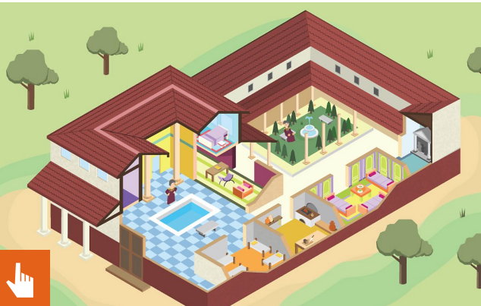
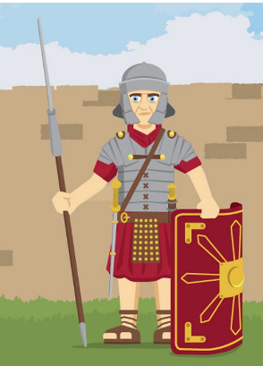
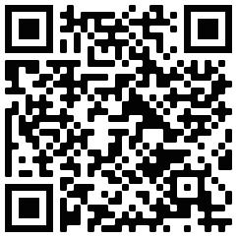
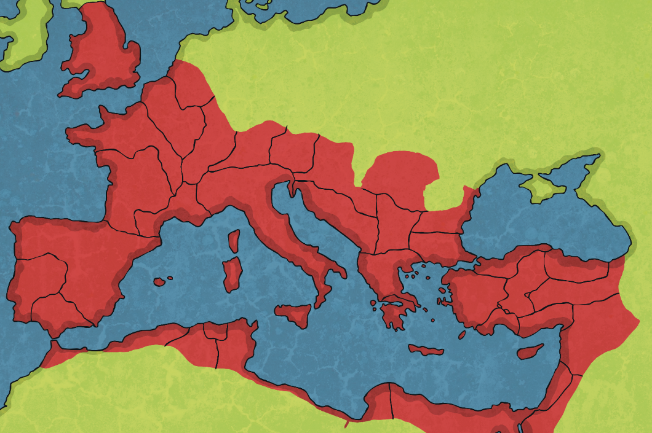
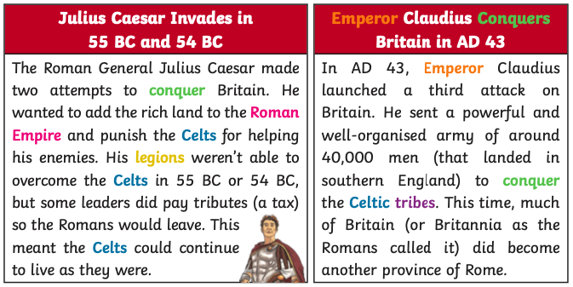
Follow the QR code to learn about my equipment!
The first Romans lived in Italy nearly 3000 years ago. They founded the city of Rome in 753BC and over the centuries, conquered many lands to create a huge empire
Follow this QR code to explore my house!
Britain used to be called Britannia
Britannia
Vocabulary | Meaning
Celts | People living in Britain and some parts of Europe after the Iron Age.
Conquest | Taking control of a place by force, often with an army.
Empire | Many countries that are ruled by one leader.
Emperor | Leader or ruler of an empire.
Boudicca | Queen of a Celtic tribe.
Legion | A large section of the Roman army, made up of around 5000 soldiers.
Settlement | A place where people decided to live.
Invasion | When a foreign army enters a country by force.
Rebel | To refuse to be controlled by an authority.
Rebellion | An uprising or revolt by people who want to challenge what is unfair treatment by rulers.
Gallia
Italia
Illyrium
Hispania
Asia

